Slide 1
PRE-HOSPITAL CARE AND DISASTER PREPAREDNESS
Dr. Zemed G. (Anesthesiologist, critical care and pain medicine)

Slide 2
OUTLINE
Pre-hospital care
Disaster
Terminologies
Disaster preparedness
Summary
Reference

Slide 3
Pre hospital care
EMS is the extension of emergency medical care into the pre-hospital setting.
In 2011, the American Board of Emergency Medicine recognized EMS as its seventh subspecialty.

Slide 4
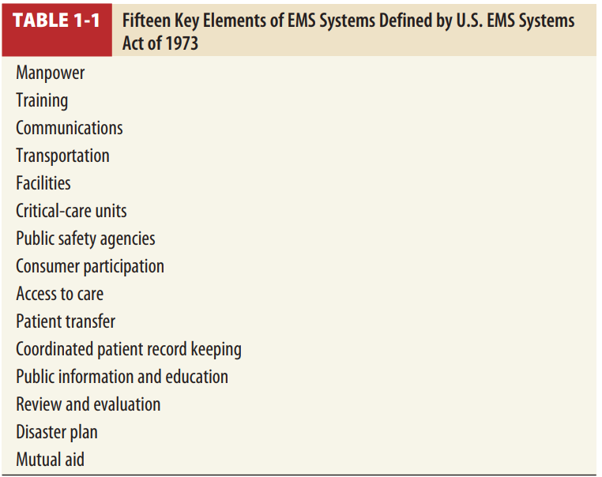

Slide 5
Manpower
These are emergency medical responder, emergency medical technician, advanced emergency medical technician, and paramedic.
Each type of provider must master a minimum set of psychomotor skills.

Slide 6
Emergency medical responders are usually first on the scene of a medical emergency.
They are trained to perform CPR, spine immobilization, hemorrhage control, use of an automated external defibrillator, and other basic interventions while awaiting an ambulance.

Slide 7
Emergency medical technicians function as part of an ambulance crew and are trained to take care of immediate life threats.
Skills include oxygen administration; CPR; hemorrhage control; and patient extrication, immobilization, and transportation.

Slide 8
TRAINING
Training includes initial provider training and continuing education.

Slide 9
COMMUNICATIONS
Widespread use of cellular telephones has prompted the development of enhanced technology to identify and locate these callers as well, in accordance with Federal Communications Commission regulations.
Emergency call takers are trained to collect the necessary information, dispatch appropriate resources, and offer first aid or pre-arrival instructions, while the ambulance is en route.

Slide 10
TRANSPORTATION
Ambulances have evolved from simple transport vehicles into mobile patient care vehicles.
Ambulance design must enable EMS personnel to provide airway and ventilatory support while transporting the patient safely
Basic life support ambulances
Advanced life support ambulances
Air transport

Slide 11
FACILITIES AND CRITICAL-CARE UNITS
Patients are often transported to the closest appropriate hospital.
PUBLIC SAFETY AGENCIES
EMS systems should have strong ties with police and fire departments.
EMS personnel often provide medical support to police and fire departments in hazardous circumstances

Slide 12
CONSUMER PARTICIPATION
Public support, both political and financial, is necessary for a good EMS system.
ACCESS TO CARE
Successful EMS systems ensure that all individuals have access to emergency care regardless of ability to pay.
Often, the EMS system is a patient’s primary point of entry into the healthcare system.
There should be no barriers or disincentives preventing timely access.

Slide 13
PATIENT TRANSFER
Patients are often transferred from one medical facility to another for a higher level of care.
Safe transfer is an important concept.
Many problems can be avoided if the transferring and receiving facilities develop transfer agreements in advance.
All patients must receive a medical screening exam and be stabilized before transfer is considered.
There must also be explicit acceptance of the transfer by the receiving hospital

Slide 14
COORDINATED PATIENT RECORD KEEPING
Maintaining good medical records is important to any patient encounter.
Pre-hospital medical records need to be legible, intelligible, and readily accessible to hospital providers.
Electronic charting and cloud-based electronic medical record

Slide 15
PUBLIC INFORMATION AND EDUCATION
EMS systems have a responsibility to train the public on how to access EMS and use it appropriately
Another important message that EMS can convey to the public is the importance of learning CPR, first aid, and basic disaster preparedness.

Slide 16
Disaster
Disasters occur in all areas of the world and cause harm to populations, property, infrastructure, economies, and the environment.
Harm to populations includes death, injury, disease, malnutrition, and psychological stress

Slide 17
A Disaster is a sudden ecological phenomenon that results in potential injury creating an effect with sufficient magnitude that requires external assistance.
A disaster occurs quite often and no nation in history has been immune from its consequences .

Slide 18
From time to time the risk of disasters is increasing and when it occurs in developing countries , the outcome is largely devastating due to a lack of preparedness and safety measures
Data shows a significant increase in the frequency of recorded disasters over the last 50 years , with almost 2 billion people affected by disasters in the past 10 years .

Slide 19
Reason ….
Improved data collection
Global warming
Increased technology
Rapid human population growth and urbanization
Civil war and conflict with a potential for population displacement
Rise of terrorism
Increased population density

Slide 20
When disaster happens both human and infrastructures are affected and usually response with available local resources is difficult therefore, always is necessary to have National Health Service response preparedness to a disaster.

Slide 21
Terminologies
Disaster - a sudden ecologic phenomenon that results in potential injury creating an effect with sufficient magnitude requires external assistance
Disaster Prevention refers to measures taken to eliminate the root causes that make people vulnerable to disaster

Slide 22
Disaster Mitigation is a permanent reduction of the risk of a disaster.
Primary mitigation refers to reducing the resistance of the hazard and reducing vulnerability
Secondary mitigation refers to reducing the effects of the hazard (preparedness).
Disaster Preparedness is the building up of capacities before a disaster situation prevails in order to reduce impacts

Slide 23
Disaster Response is the set of activities implemented after the impact of a disaster in order to assess the needs, reduce the suffering, limit the spread and the consequences of the disaster.
Risk is the product of the probability of the occurrence of the hazard and its consequences . It is the product of hazard and vulnerability .

Slide 24
Risk mapping is the process of establishing geographically where and to what extent particular hazards are likely to pose a threat to people, property, and the environment.
Relief is the provision of immediate shelter; life support including medical care and the needs of persons affected by a disaster.

Slide 25
Mass casualty incident : Any event resulting in a number of victims large enough to disrupt the normal course of emergency and health care services . In our hospital context, the number of patients is 12 or more.

Slide 26
TYPES OF DISASTERS
External disasters
An internal disaster
Both internal and external

Slide 27
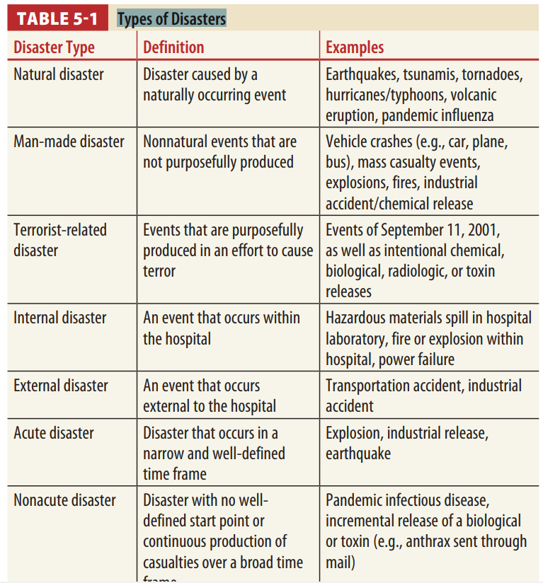

Slide 28
DISASTER CHARACTERISTICS
Regardless of the cause, most disasters have common characteristics that are important for disaster preparedness and planning.
Initial patients can be expected within minutes, and peak volumes can be expected at 2 to 3 hours after the event.
The vast majority (~80%) of patients are not transported by pre-hospital agencies, but instead self-transport by car, van, police vehicle, cabs, foot, or any means available to the nearest ED

Slide 29
Emergency and disaster risk management
Integrated approach
Commonwealth, State/Territory local governments, the private sector and the community
Comprehensive approach:
encompasses prevention, preparedness, response and recovery
Agent-specific approach
All-hazards approach

Slide 30
Disaster Preparedness

Slide 31
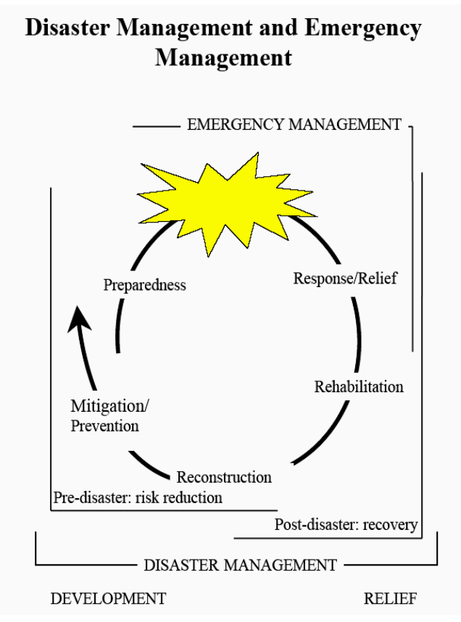
Phases of Disaster Management
Preparedness
Response
Recovery

Slide 32
Disaster preparedness and planning
General steps of disaster preparedness:
Preparedness consists of three basic steps: preparing a plan, training to the plan, and exercising the plan
Risk and vulnerability assessment
Disaster preparedness plan document development
Discussion and review with relevant bodies

Slide 33
Approval by the higher management
Dissemination
Regular Staff education and training using the hospital disaster/emergency manual
Testing

Slide 34
Hazard, Risk /Vulnerability Analysis
Hazard mapping
Risk analysis
Vulnerability assessment
Resource mapping
Stakeholder analysis

Slide 35
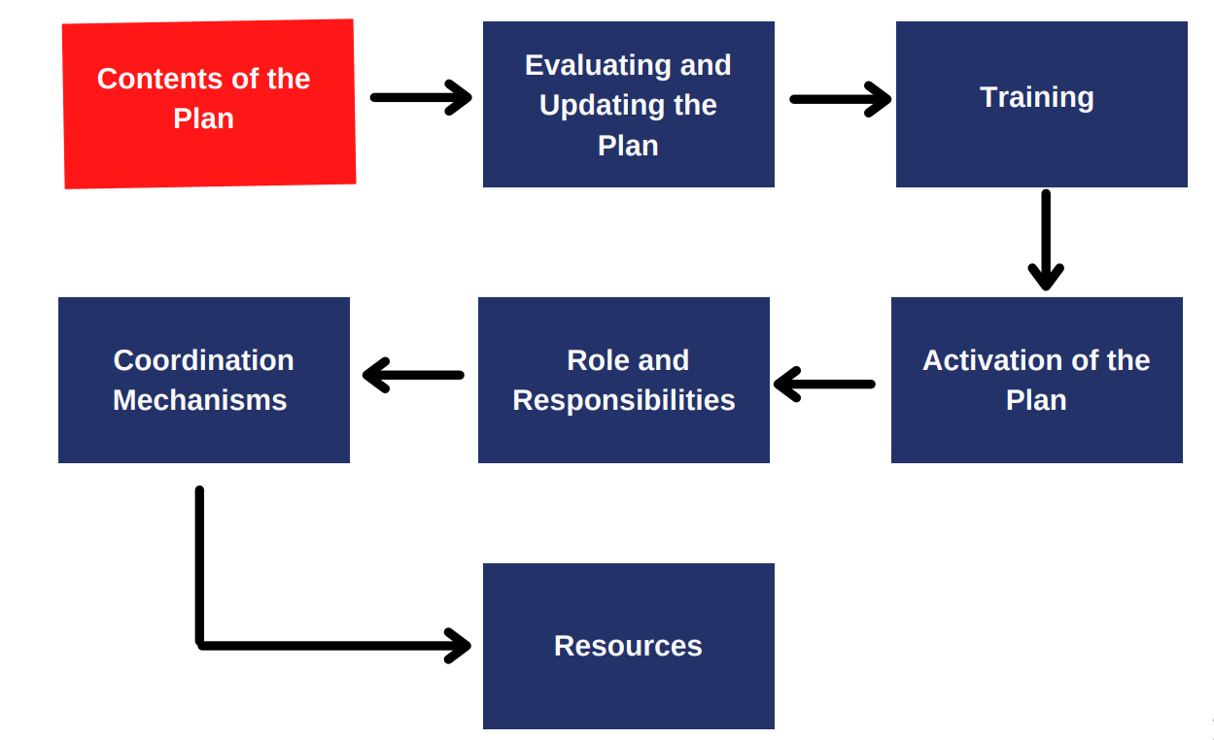
Steps During Disaster Preparedness

Slide 36
Disaster Response
Response is the immediate reaction to disaster.
It may occur as the disaster is anticipated, as well as soon after it begins.
Includes: mass evacuation, securing emergency food and water, providing emergency medical services, extrication, triage, stabilization, and transport

Slide 37
Disaster Recovery
Recovery involves decisions and actions relative to rebuilding homes, replacing property, resuming employment, restoring business, and permanently repairing and rebuilding infrastructures.

Slide 38
The four elements of recovery are:
1. Community recovery (including psychological recovery)
2. Infrastructure recovery (services and lifelines)
3. Economy recovery (including financial and political considerations, and business continuity)
4. Environment recovery

Slide 39
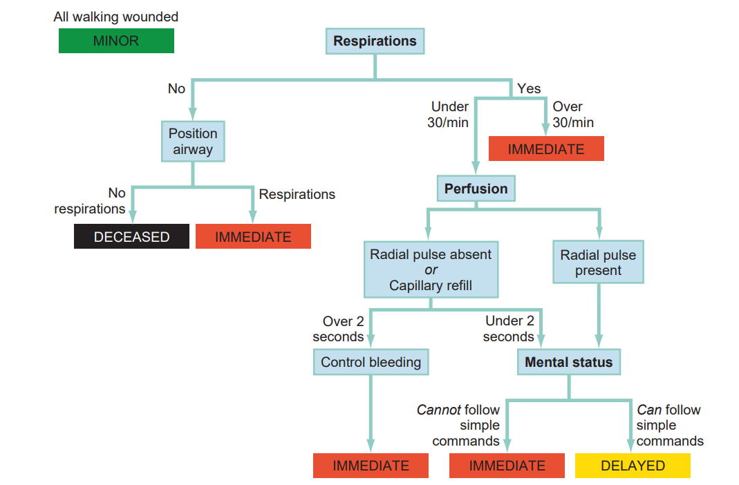
TRIAGE

Slide 40
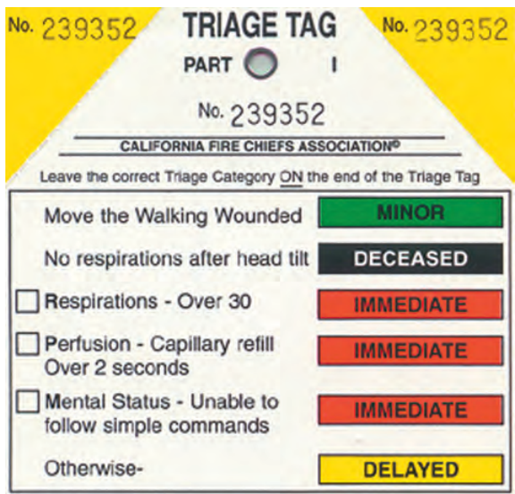
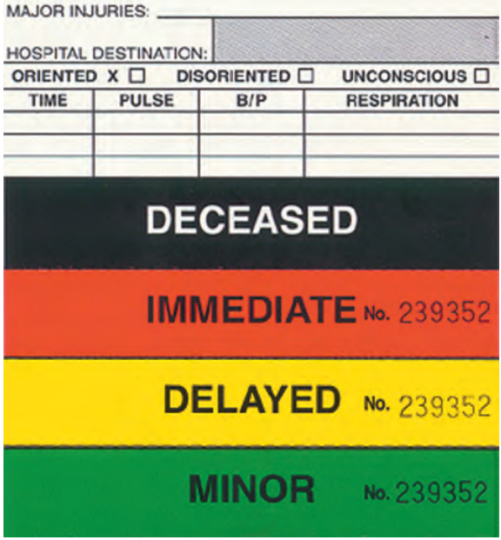

Slide 41
Catastrophic Casualty Management
Triage during a widespread, catastrophic disaster differs from triage performed in routine out-of-hospital and hospital settings.
The number of victims is vastly increased, while medical resources are severely limited or even initially absent.
While medical resources are severely limited or even initially absent. Patients may remain on scene for an extended period and should be frequently reassessed

Slide 42
Secondary Assessment of Victim Endpoint (SAVE) system of triage
Divides patients into three categories:
those who will die regardless of care
those who will survive without care
those who will benefit from austere field interventions.

Slide 43
The SAVE methodology is designed for use by health care providers under two conditions:
for those working within the disaster zone that begin caring for patients immediately but may not be able to transport patients to a definitive care facility for days
for those caring for patients within hospitals where demand for resources exceeds supply

Slide 44
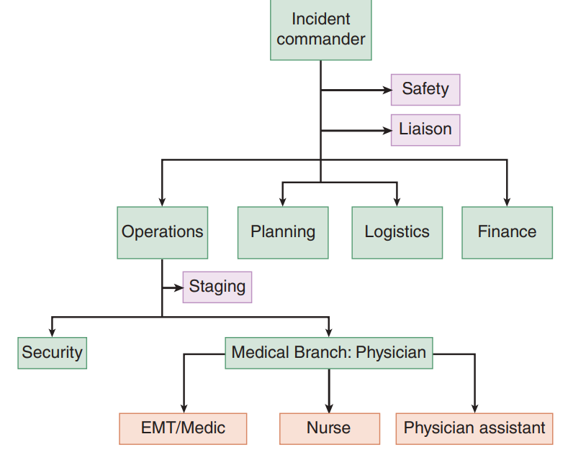
Summary

Slide 45
Reference
Tintinallis Emergency Medicine a comprehensive study guide 8th edition
Rosen’s emergency medicine: concepts and clinical practice 9th edition
Lecture note on disaster Prevention and Preparedness
St. Peter specialized hospital's disaster plan
Textbook of adult emergency medicine

Slide 46
Thank you

